Slide 1
Passerelles numériques
Chapter1.1: PHP OOP
A Gateway for Life
Lesson 01: Class and Object

Slide 2
CONTENTS
Class
  Definition of class
  Syntax to define/declare/initialize class
  Class Attributes
  Class Method
Object
  Definition of Object
  Syntax to declare/define/initialize object
Constructor
Notes:
appendchild

Slide 3
Definition of a Class
A Class is user defined data type that contains data members and methods which work on the data members
To create a class, you need to use the keyword class followed by the name of the class. The name of the class should be meaningful to exist within the system.
The body of the class is placed between two curly brackets within which you declare class data members/variables and class methods.
Notes:
Data Member = Variables
Curly = arranged រៀបចំ

Slide 4
Syntax of define a Class
Following is a prototype of a PHP7 class structure
class <class-name> {
<class body :- Data Members and Methods>;
}

Slide 5
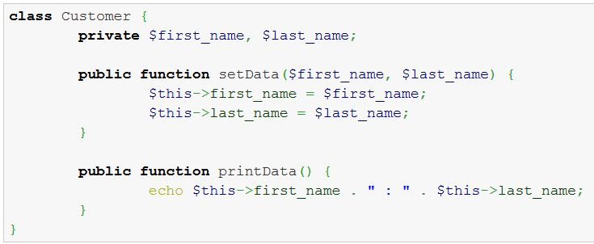
Syntax of define a Class
Keyword to define class.
Class-Name
Data Member/Variable
1
1. Methods

Slide 6
Definition of Object
A class is a template for generating objects.
An objects is data that has been structured according to the template defined in a class.
Object is called instance of class.
To create an object of a PHP7 class, we use the keyword new.

Slide 7

Syntax of declare Object
Syntax style of how to create objects in PHP7:

Slide 8
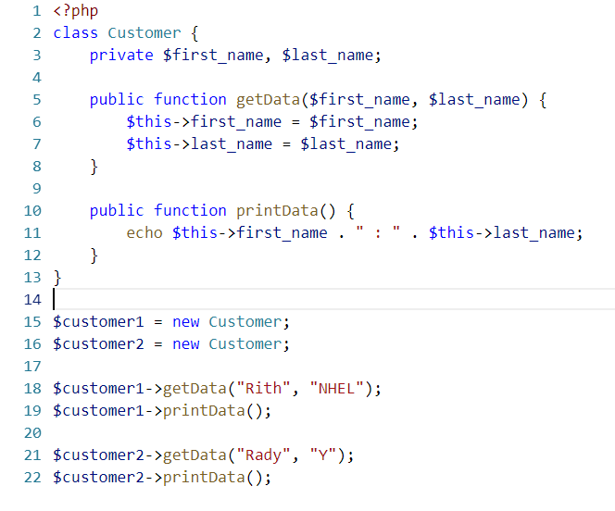

Syntax of declare Object
Result:

Slide 9
Class Attribute
An attribute is also know as data members and is used to hold data of a class.
The data that it holds are specific to the nature of the class in which it has been defined.
EX: a Customer class would hold data related to a customer, an Order class would hold data related an order.

Slide 10
Class Attribute
Defining an attribute is an easy as declaring a variable within the body of the class. At the time of declaring a data member/variable within the body of the class, it is also possible to assign a default value to the attribute or data member.
Attributes can either be public, private or protected (the default being public).

Slide 11
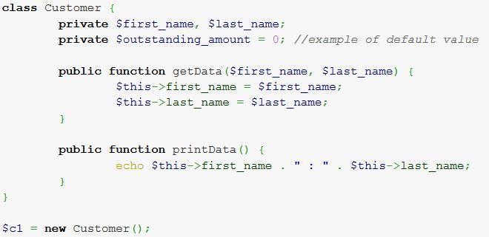
Class Attribute

Slide 12
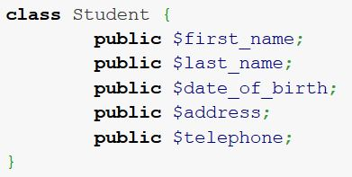
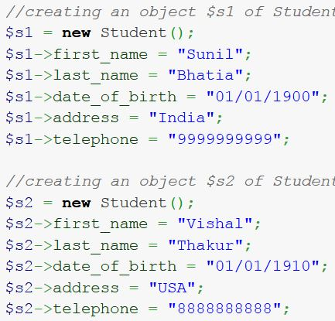
Class Attribute

Slide 13
Class Method
A class method/functions is the behavior or functionality of a class.
Ex: could be a saveCustomer() method in the class Customer or a printDocument() in the Document class.
Method act (perform operations) on the data members of the class and can be declared as private or public. A class method is exactly similar to PHP functions, it’s just that class functions are declared inside classes and accessed using the “->” (arrow operator / dereferencing operator ).
Notes:
Dereferencing =

Slide 14
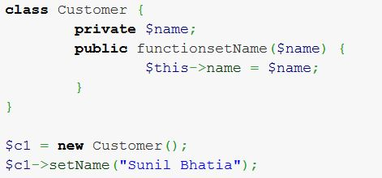
Class Method

Slide 15
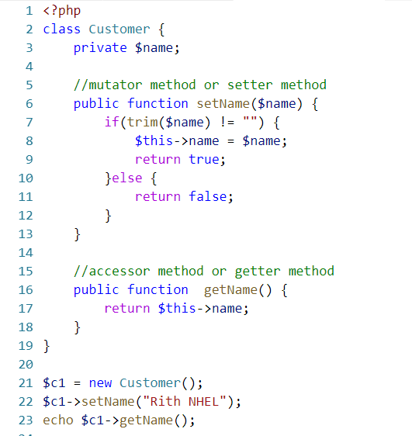
Class Method

Slide 16
Constructor
A constructor is a special function of a class that is automatically executed whenever an object of a class gets instantiated.
Constructor methods has name the same class name.
Start from PHP5, we write constructor methods __construct().
PHP 4 does not recognize the __construct() method as a constructor.

Slide 17
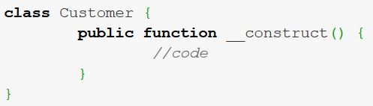
Constructor
Following is the prototype or the syntax of creation constructor:

Slide 18
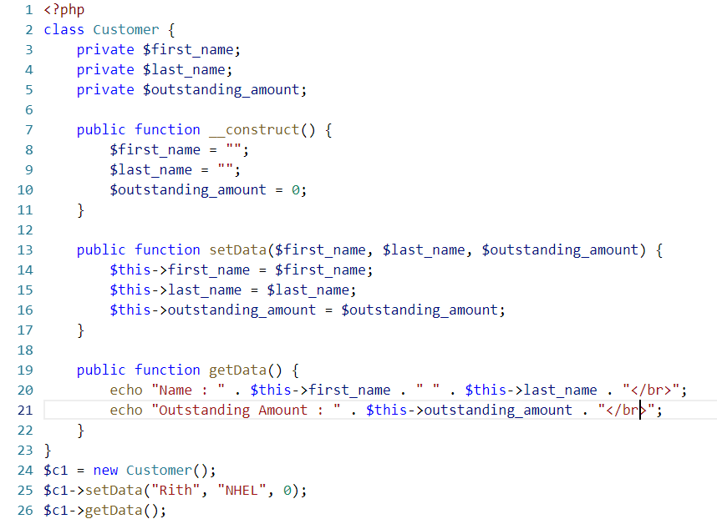
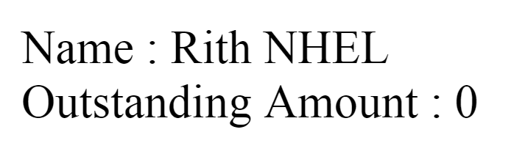
Constructor
Result:

Slide 19
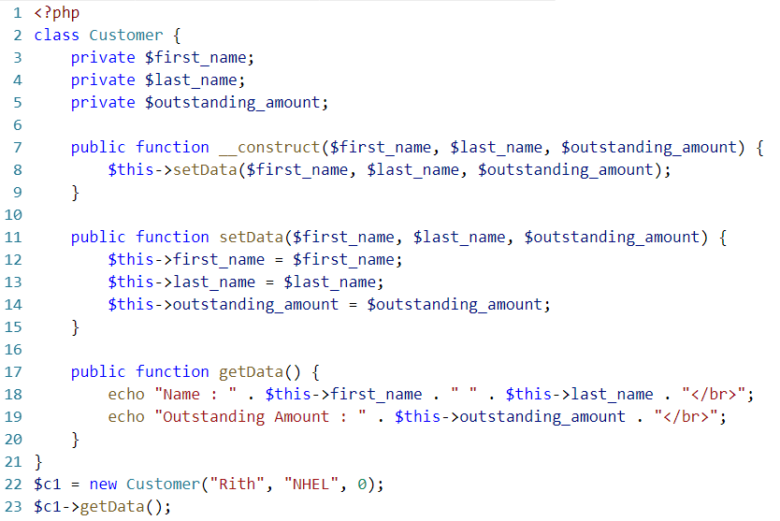
Result:

Slide 20
Activity#1
  Write program to show baseurl:
  http://localhost/myproject
10 minutes
Notes:
<?php
class show_url{
private $m_baseUrl='';
function __construct($baseUrl){
$this->m_baseUrl=$baseUrl;
}
public function render() {
$baseUrl=$this->m_baseUrl;
return $baseUrl;
}
}
$baseUrl=new show_url('http://localhost/myproject');
echo $baseUrl->render();

Slide 21
Demo

Slide 22
Q&A

Slide 23
What have you learned?
Notes:
Ask student to give quick summary what they have learned

Slide 24
SUMMARY
Class
  Definition of class
  Syntax to define/declare/initialize class
  Class Attributes
  Class Method
Object
  Definition of Object
  Syntax to declare/define/initialize object
Constructor

